Slide 1
PDM Implementations
Training plan template
Jussi Eskelinen
2003-03-18, v 0.1

Slide 2
Introduction
This document is made to ease the construction of PDM implementation training plan. It is recommended by ECC to use this document as template when making training plan.
comments to jussi.eskelinen@metso.com

Slide 3
Introduction
This template includes tools for:
  identifying training needs
  identifying training methods
  identifying training environments
  composing training groups
  identifying trainer training needs
  making training schedule
  identifying training material creation and maintenance needs
  allocating resources
  planning training feedback gathering

Slide 4
Training organisation (trainers / key-users)
Trainers/key users:
  Anders Kulonen, dept. num. (Project engineer training)
  Jaakko Pöyry, dept. number (Overviews)
  Kari-Pekka Varis, dept. number (Translators)
  Kiril Andersen, dept. number (Administrator trainings)
Key users:
  Ukko Pekkala, dept. number
  Pekka Ukkola, dept. number
  Anssi Kukkonen, dept. number

Slide 5
Business roles on this site
e.g. Winder Project engineer
e.g. Winder Product engineer
e.g. Winder Logistics engineer
e.g. Winder Reader
e.g. Winder Translator
e.g. Winder Local System Administrator
etc...

Slide 6
Training material creation and maintenance
Training material will be produced during xx.-xx.xx.2003
Creators:
  Anders Kulonen (Project engineer training)
  Jaakko Pöyry (Overviews)
  Kari-Pekka Varis (Translators)
  etc.
Maintenance: Businesses own Implementation template PDM -database and PDM Training material -database (see PDM training material maintenance template)

Slide 7
Training facilities
Class rooms:
  PC 1
    Equipment:
      - projector
      - 8+1 computers
  PC 2
    Equipment:
      - projector
      - 8+1 computers
  Auditorium 1
    Equipment:
      -projector

Slide 8
Users
See the e.g. Winder Business configuration data -document on Winder PDM database

Slide 9
Training groups
Group 1:
  Nano Nano, department number
  Uno Uno, department number
  Name Name, department number
  Firstname Lastname, department number
  Firstname Lastname, department number
  Nano Nano, department number

Slide 10
Training groups
Group 2:
  Nano Nano, department number
  Uno Uno, department number
  Name Name, department number
  Firstname Lastname, department number
  Nano Nano, department number
  Uno Uno, department number
  Name Name, department number
  Firstname Lastname, department number

Slide 11
Training groups
Group 3:
  Nano Nano, department number
  Uno Uno, department number
  Name Name, department number
  Firstname Lastname, department number
  Firstname Lastname, department number

Slide 12
Training groups
Group 4:
  Nano Nano, department number
  Uno Uno, department number
  Name Name, department number
  Firstname Lastname, department number
  Nano Nano, department number
  Uno Uno, department number
  Name Name, department number
  Firstname Lastname, department number

Slide 13
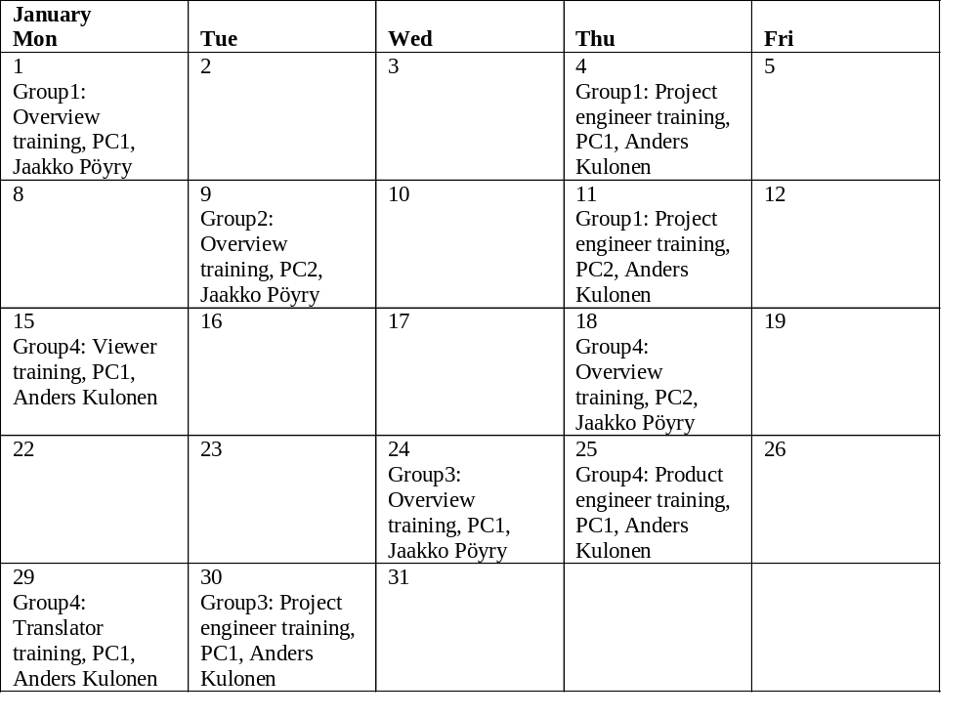
Schedule (January)

Slide 14
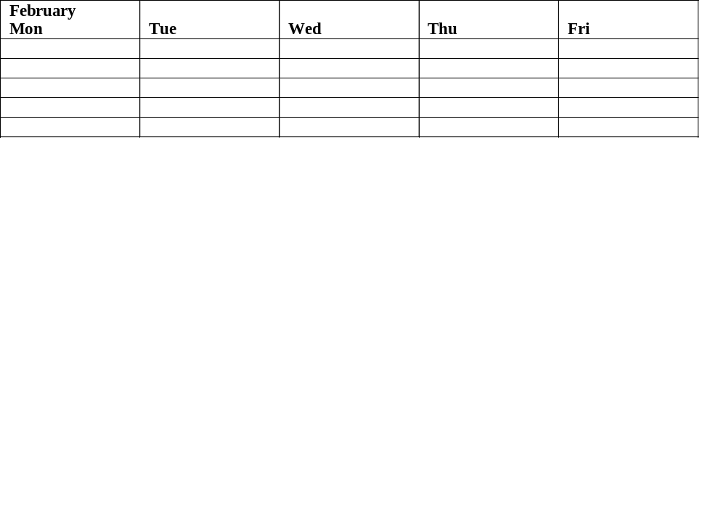
Schedule (February)

Slide 15
Training feedback gathering
“Nano Nano” (spokes person on this site) will make the feedback requests after every training session.

Slide 16
Post training support
After implementation training key users and trainers provide support to end users (hands on, email, HelpDesk, etc…)
Businesses training responsible person or comparable person (HR) ensure that everybody has participated proper PDM training sessions and PDM training is arranged to new employees
Trainers maintain their preparedness to train end users
Training material will be still updated by trainers

Slide 17
Other
Other information

